Slide 1
Restaurant Opening Analysis
IBM Data Science Professional Certificate
Capstone Project Presentation
Rooshdean Solomons January 2020

Slide 2

Introduction
Canada is a country that has such high a regard for family and quality of life. Most people in the world first think of immigrating to Canada before any other country because of this. The world loves food and there can never be enough options when in any country or area. Toronto being the capital has so much potential for entrepreneurs. Toronto is arguably one of the most interesting places in the world. Toronto is home to 8,100 restaurants and bars, representing 6.5% of all businesses in the city. The multicultural population of the GTA is expected to reach 9 million people by 2036. Indicating that the demand and need for more restaurants and bars will increase. We want to establish, by doing some analysis, which area in Toronto would be the best to set up a new restaurant.
Marketing consultants has determined that we must pay special attention to entertainment services, because they are considered attractive to potential customers. It's very common that people go to the restaurant after the theatre or other kind of social activities.
We also must take into account other food services offerings that could be considered in some cases rivalry or, in other cases, complementary.¶

Slide 3
Methodology
In order to meet the above objectives, several data sources are required. We need to establish which area in Toronto has the best opportunity for a restaurant business to be successful.
Web scraping of Canada data on Wikipedia for list of postal codes and areas.
For geolocation of the Toronto neighbourhoods, Python geocoder will be used.
Foursquare provides venue data for Toronto restaurants of interest
In the following we will compile the aforementioned data in data frames and quickly characterize their properties.

Slide 4
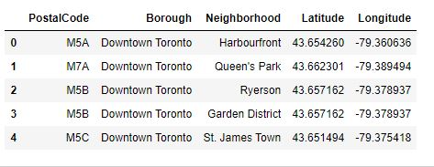
Data Preparation
After doing data wrangling/cleaning on the geographical data of Canada. I only needed Toronto area and cities data as the report is based on an opening of a restaurant in Toronto.

Slide 5
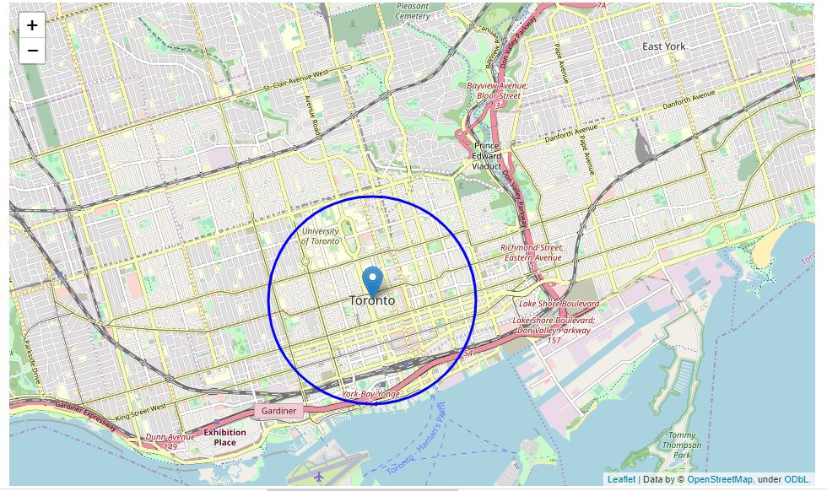
Area on map of Toronto
This is the radius on the map. Data Analysis was done for.

Slide 6
Descriptive Analysis
Descriptive Analysis: was used in order to have a better understanding of the venues and its spatial distribution across neighbourhoods. Statistics as mean, median, mode and graphs, bar charts and histograms were employed to enhance insight.
K-Means: was the algorithm herein applied for data clustering, because it is simple to understand and deploy and provides further insight into the data, by grouping the neighbourhoods according to their secondary venue types.

Slide 7
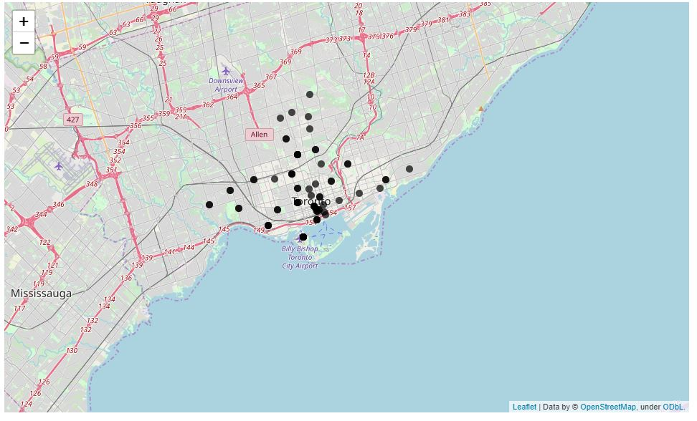
Final Map after Clustering

Slide 8
Results and Discussion
Our analysis shows that there is a great amount of restaurants in Toronto and that a lot of people are very active. By active I mean that they eat a lot and have very frequent visits. The area covered was mainly central Toronto but mostly all major cities in Toronto.
We also established some great insights from the dataset. Every area in Toronto has different type of preferences. Its almost as if every area has its own professional cook as we never find the same type of food for 2 or 3 different cities. We also now know that the demand for food and restaurants is very high as people who live in Toronto have a big appetite according to the data.
As a entrepreneur or a business owner we can establish that there is a opportunity to start a restaurants business. Knowing the demand you have know what type of food people like in a specific area. Different area have different requirements. When clustering the data with k means, that is how I established that.

Slide 9
Conclusion
We have gathered data from trusted sources and a known and strong methodology has been applied for processing
A group of five neighbourhood has been selected from more that on hundred that Toronto has.
In such neighbourhoods there are English Restaurants, Fast Foods and Pizza. Also the different cuisines in the different area was really a great discovery. .
We consider that in one of them will be able to start the profitable and fruitful business endeavour.

